Slide 1
BIOMEDICAL INSTRUMENTATION
MODULE-4 Part-2
PROF. DR. JOYANTA KUMAR ROY
DEPARTMENT OF APPLIED ELECTRONICS & INSTRUMENTATION ENGINEERING
NARULA INSTITUTE OF TECHNOLOGY
WWW.dr-joyanta-kumar–roy.com

Slide 2
Subjects of discussion
Medical imaging
Ultrasonography (USG)
Medical Thermography (IR)
The Module -3 part-2 course duration : 1 lecture
The lecture content will be available at http//www.dr-joyanta-kumar-roy.com

Slide 3
THERMAL IMAGING SYSTEM
Medical Thermography

Slide 4
INFRA RAY - Physics behind it…….
Radiography provides essential information on anatomical structures and abnormalities while Thermography indicates metabolic process and circulation changes.
The Human body absorbs all most all infra red radiation but it also emits part of its own Thermal energy in the form of infrared radiation.
Thermography is the technology of visualising the radiation pattern of the human organ brought about by pathologicval changes and is a real time system

Slide 5
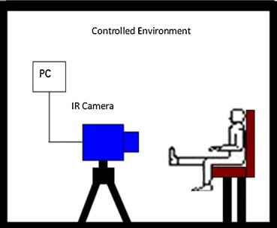
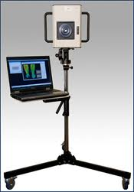
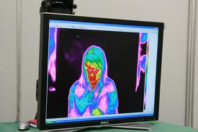
This equipment usually has two parts, the IR camera and a standard PC or laptop computer. These systems have only a few controls and relatively easy to use.
Monitors are high-resolution full colour, isotherm or grey scale, and usually include image manipulation, isothermal temperature mapping, and point-by-point temperature measurement with a cursor or statistical region of interest. The systems measure temperatures ranging from 10° C - 55° C to an accuracy of 0.1° C. Focus adjustment should cover small areas down to 75 x 75mm.

Slide 6
Infrared Energy & Radiation
  Part of electro magnetic spectrum
  It travels through space at the speed
  of light.
  The thermal energy emitted from the
  surface of a material is called IR
  radiation.
  Temperature of an object=IR radiation
  emitted from it.
  E.g.: x-ray, ultra violet, radio waves.

Slide 7
Electromagnetic Spectrum
Infrared radiation, visible light & ultra violet
light form energy in spectrum.
Categorized by wave length & frequency.
Human eye can see narrow range of
wavelength.(0.4-0.75 micron)

Slide 8
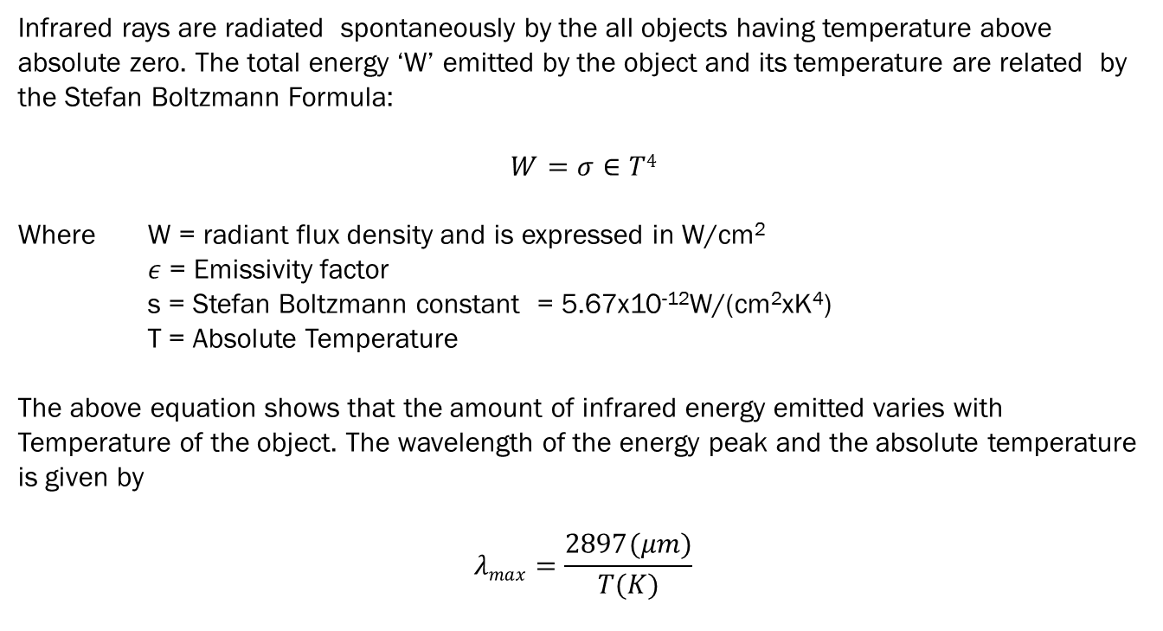
PHYSICS OF THERMOGRAPHY
Infrared rays are radiated spontaneously by the all objects having temperature above absolute zero. The total energy ‘W’ emitted by the object and its temperature are related by the Stefan Boltzmann Formula:
$$W=σ∈T4$$
Where W = radiant flux density and is expressed in W/cm²
$ε$ = Emissivity factor
s = Stefan Boltzmann constant = 5.67x10⁻¹²W/(cm²xK⁴)
T = Absolute Temperature
The above equation shows that the amount of infrared energy emitted varies with Temperature of the object. The wavelength of the energy peak and the absolute temperature is given by
$$λmax=\frac{2897(μm)}{T(K)}$$

Slide 9
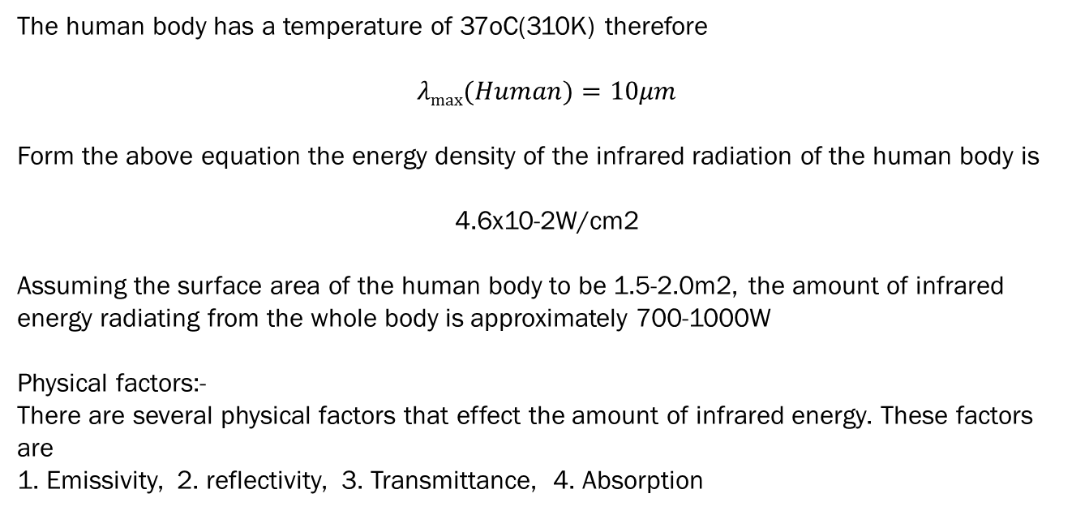
PHYSICS OF THERMOGRAPHY… Contd.
The human body has a temperature of 37oC(310K) therefore
$$λmax⁡(Human)=10μm$$
Form the above equation the energy density of the infrared radiation of the human body is
4.6x10-2W/cm2
Assuming the surface area of the human body to be 1.5-2.0m2, the amount of infrared energy radiating from the whole body is approximately 700-1000W
Physical factors:-
There are several physical factors that effect the amount of infrared energy. These factors are
1. Emissivity, 2. reflectivity, 3. Transmittance, 4. Absorption

Slide 10
Thermography?
It’s a - infrared imaging science.
- cost effective method.
- non invasive method.
- non contact method.
Applications include building diagnostics,
plant maintenance, research, etc.

Slide 11
What IS THE TECHNOLOGY?
IRT is the technique that used for producing a visible image of invisible
IR energy emitted by objects.
Since wavelength is too long for the
sensors in our eyes, IR cameras are used.
IRT is the technique that used for producing a visible image of invisible
IR energy emitted by objects.
Since wavelength is too long for the sensors in our eyes, IR cameras are used

Slide 12
Where THE TECHNOLOGY is used?
It can be applied in any situation where a problem or condition can
display itself by means of a “thermal difference”.
For example, firefighters use it to see through smoke,
find persons, and localize hotspots of fires. Cooled IR
cameras can also be found at most major astronomy
research telescopes.

Slide 13
What makes it useful?
Its non contact.
-uses remote sensing, keeps the user out of danger.
It is two dimensional.
-thermal patterns can be analyzed, comparison
between areas of target is possible.
It is real time.
-fast scanning of stationary targets, capture of fast
moving targets & fast changing thermal patterns.

Slide 14
THE WORKING Principle
Black body radiation-Black body is that which absorbs completely all
the radiations falling on it.
The law is associated with “Thermodynamics”.
Every object whose surface temperature is above
absolute zero (-273 °C) radiates energy at a
wavelength corresponding to its surface temperature.

Slide 15
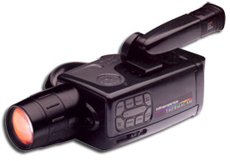
Thermographic Camera
Produces a live TV image of heat radiation.
It converts invisible IR energy into a 2d visual image & displays on std.
TV monitor.
Thermal image produced is called thermogram.
It allows us to see what our eyes can't.
It resembles a std. camcorder.

Slide 16
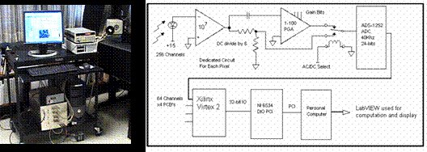
How Digital imaging obtained in Thermal Camera

Slide 17


How camera see heat?
It can image temperatures from -20 to 500
degree Celsius & can be extended down to
-40 & up to 2000 degree Celsius.
It converts invisible IR
energy to 2d visual image.
Then displays on a TV
monitor.
www.techalone.com

Slide 18
Types of Thermographic Cameras
2 types:
Cooled cameras-They are contained in a vacuum sealed case & cryogenically cooled.
Drawbacks-
expensive to produce & run, several minutes to cool down before it begin working.
Uncooled cameras-Use sensors that work by
change of resistance, volume & current when heated. It is smaller & less costly.
Cooled cameras provide superior image quality than
uncooled.

Slide 19
Process
IR camera creates an image.
-convert radiant heat energy into a signal.
Colorizing IR images.
-camera assigns black to coolest area &
white to hottest area.
Adjusting images for clarity.
-upper & lower temperature limits are adjusted to get the clearest picture.

Slide 20
Applications
Medical imaging
Night vision
Non destructive testing
Medical field
Condition monitoring

Slide 21
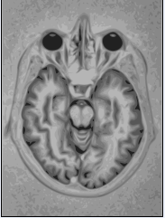
Medical Imaging
The technique used to create images of human body
for clinical purposes or
medical science.
Imaging technology:
Electron microscope.
Fluoroscopy.
Magnetic Resonance Imaging (MRI).
Positron Emission Tomography (PET).
Ultrasonography

Slide 22
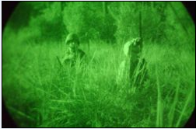
Night Vision
Ability to see in a dark environment.
Possible by 2 approaches: spectral range, intensity range.
NVD used in military forces.
Absence of Tapetum lucidum is the reason for poor night vision
in humans.
Thermal imaging cameras helps in seeing through fog,
rain and smoke.

Slide 23
Non-Destructive Testing (NDT)
It is the testing that does not destroy
the test object.
Aimed mainly at industrial NDT.
Destructive testing is not possible for forensic
investigation.
Eg:-Aircraft skins need regular checking to detect
cracks.
    Underground pipelines are subject to corrosion
    & stress corrosion cracking.

Slide 24
ConTd….
-Human beings
Respiratory dysfunctions- asthma, bronchitis
Digestive disorders-hyper &hypo gastric secretions.
Urinary diseases-urinary tract inspections.
Cardiovascular & circulatory
disorders-heart disease, varicose vein.
Nervous dysfunctions-brain, spinal cord, nerves.

Slide 25
Cond…
Locomotors disorders-arthritis, disk injury.
Surgical assistance-tumours size, surgical area.
Skin problems-skin cancer & tumours.
Dentistry-inflammation in oral cavity.
Endocrine disorders-hypo & hyperthyroidism.
Ear, Nose & Throat dysfunctions-tonsillitis,
sinusitis.

Slide 26
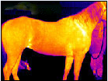
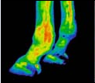
Medical Thermography
It can be done in 2 fields
-Vetinary Minor injuries to muscle tissue may
go unnoticed until the problem is more severe.IR
imaging aids expert trainer in caring for the horse.

Slide 27
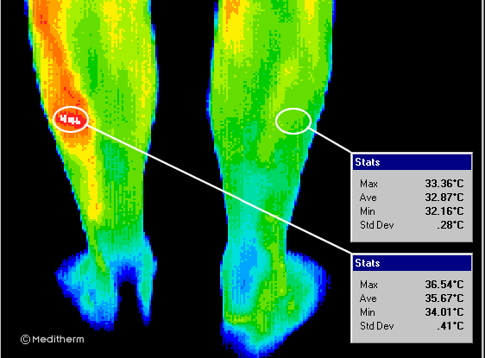
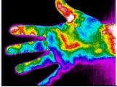
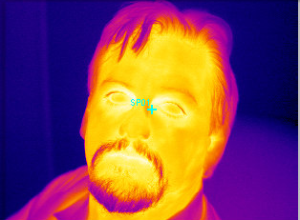
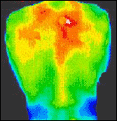
Some Examples

Slide 28
Condition Monitoring
Monitoring a parameter of condition in
machinery, such that a significant change is
indicative of a developing failure.
Major component of predictive maintenance.
Cost effective than allowing the machinery
to fail.
Serviceable machinery-rotating machines
& stationary plant like boilers, heat exchangers.

Slide 29
Condition Monitoring
Electrical maintenance-camera can see the
difference in the heat of defected & normal components.
Buildings-monitors the heat loss & air leakage.
Furnace & boilers-finds incipient defects in power plant equipment.
Tanks & vessels-inspects for tank leaks & to verify tank level.

Slide 30
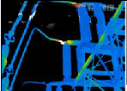
ConTd…..

Slide 31
Active & Passive Thermography
In passive thermography, inspected parts are
naturally at a higher or lower temperature than
the background.
In active thermography, an energy source is
required to produce a thermal contrast.
The defects can be either detected as
hot (active) or cold spots (passive) on
the surface.

Slide 32
Advantages
Non-destructive test method.
Capable of catching moving targets in
real time.
Find defects in shafts and other metal parts.
Measurement in areas inaccessible or
hazardous for other methods.
Condition monitoring.
Help to compare temperatures over a
large area .

Slide 33
Limitations
Training and staying proficient in IR
scanning is time consuming.
Images is hard to interpret accurately
even with experience.
Quality cameras have a high price range.
Cameras have worse accuracy.

Slide 34
Conclusion
Thermography enables us to see and measure heat.
It is a method that utilizes a thermal image to detect, display and
record thermal patterns and temperatures across the surface of an object.
It is the future in water damage and mold claims adjudication for the insurance industry.

